Slide 1

Music Recommender System
Presented by: Eddie Amaitum
05 - June - 2023

Slide 2
Problem Definition
Today we live in a world of rapid technological advancements
Result: Distractions hence limited time to consume good content
Platforms rely on recommender systems to retain user attention
The challenge of predicting top_n songs is easy to understand for a non technical audience

Slide 3

Objective
Build a recommendation system to predict the top_n songs for a user based on the likelihood of listening to those songs
Showcase my ability to develop ML tools and lay foundation for deploying and end - to - end ML process

Slide 4
Data:
Taste profile subset by Echo Nest: millionsongdataset.com
Song data (song_id, title, release,artist_name, year) 1,000,000 records
Count data (user_id, song_id, play_count) 2,000,000 records
It is freely available to the public

Slide 5
Solution Approach
Data cleaning + Feature engineering
Exploratory data analysis
1
2
3
4
5
6
Rank / Popularity based recommendation system
User - User similarity based collaborative filtering
Clustering - based recommendation system
Item - Item similarity based collaborative filtering
Matrix factorization
Content based recommendation system

Slide 6
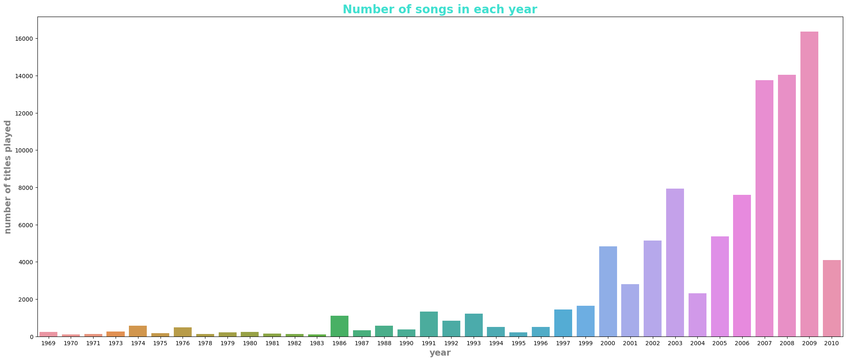
Distribution of songs

Slide 7
Solution Approach
Key observations & insights:
The final data was sparse
Data filtered to retain < = 5 song play_count
‘‘Corrected_ ratings’’ utilized
Hyperparameters tuned to improve models

Slide 8
Performance Metrics:
Precision @ k : The fraction of recommended items that are relevant in top k predictions
Recall @ k: The fraction of relevant items that are recommended to the user in top k predictions
RMSE: Checks how far the overall predicted ratings are from the actual ratings
F1_Score @ k: The harmonic mean of Precision @ k and Recall @ k
Solution Approach

Slide 9
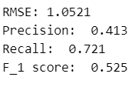
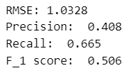
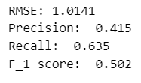
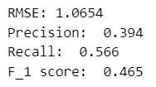
Item - Item
Similarity
User - User Similarity
Model based/Matrix factorization
Cluster based

Slide 10
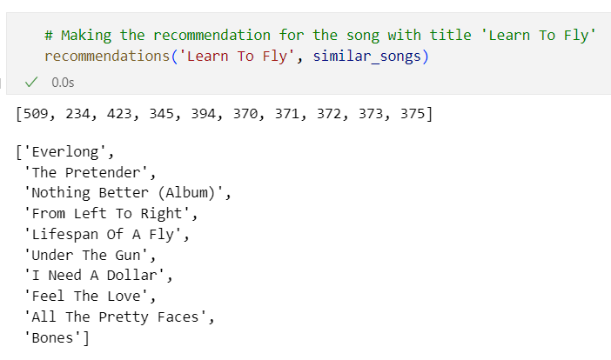
Sample recommendation

Slide 11

Proposal for future solution design and outlook
A robust hybrid recommendation system will be used
I will build an interactive tool showcasing the end to end machine learning process
Hyperparameter tuning will be done to improve model performance
Continuous training on new data to improve model

Slide 12


